Slide 1
Lecture 9: Models with movement
May 31, 2016

Slide 2
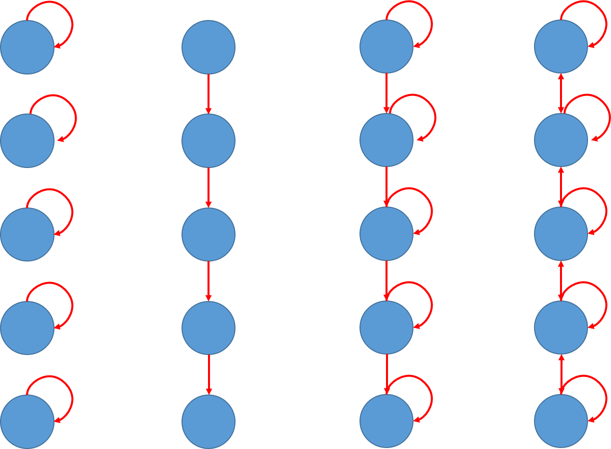
Different forms of movement
No movement
Rail car
Partial migration
Diffusion

Slide 3

Different forms of movement
$$\frac{d}{dt}b=Mb$$
M =
No movement
1
 | 1
 |  | 1
 |  |  | 1
 |  |  |  | 1

Slide 4
Different forms of movement
$$\frac{d}{dt}b=Mb$$
M =
Rail car
1
 | 1
 |  | 1
 |  |  | 1 | 1

Slide 5
Different forms of movement
$$\frac{d}{dt}b=Mb$$
M =
Partial migration
1-p
p | 1-p
 | p | 1-p
 |  | p | 1-p
 |  |  | p | 1

Slide 6
Different forms of movement
$$\frac{d}{dt}b=Mb$$
M =
Diffusion
1-p | p
p | 1-2p | p
 | p | 1-2p | p
 |  | p | 1-2p | p
 |  |  | p | 1-p

Slide 7
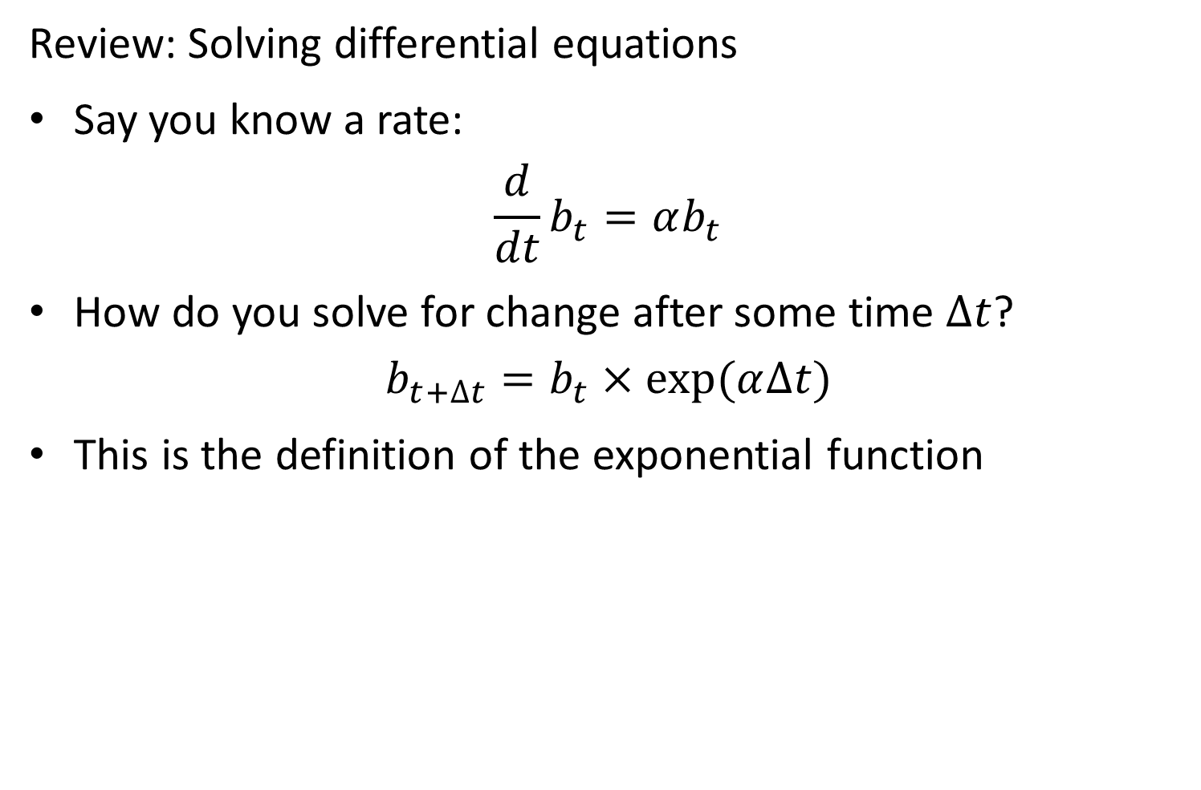
Review: Solving differential equations
Say you know a rate:
$$\frac{d}{dt}b_{t}=αb_{t}$$
How do you solve for change after some time $∆t$?
$$b_{t+∆t}=b_{t}×exp⁡(α∆t)$$
This is the definition of the exponential function

Slide 8
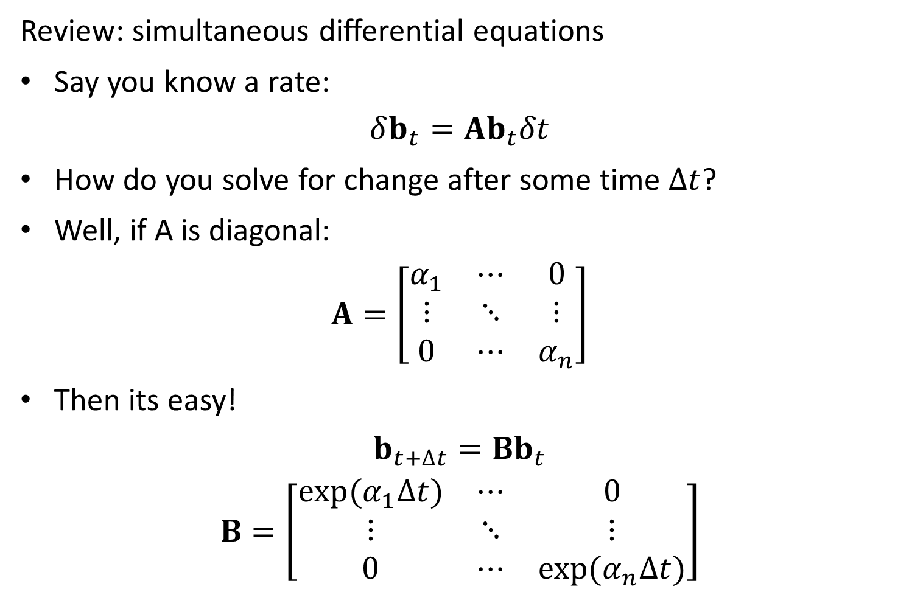
Review: simultaneous differential equations
Say you know a rate:
$$δb_{t}=Ab_{t}δt$$
How do you solve for change after some time $∆t$?
Well, if A is diagonal:
$$A=\left[\begin{matrix}α_{1} & ⋯ & 0 \\ ⋮ & ⋱ & ⋮ \\ 0 & ⋯ & α_{n}\end{matrix}\right]$$
Then its easy!
$$b_{t+∆t}=Bb_{t}$$
$$B=\left[\begin{matrix}exp⁡(α_{1}∆t) & ⋯ & 0 \\ ⋮ & ⋱ & ⋮ \\ 0 & ⋯ & exp⁡(α_{n}∆t)\end{matrix}\right]$$

Slide 9
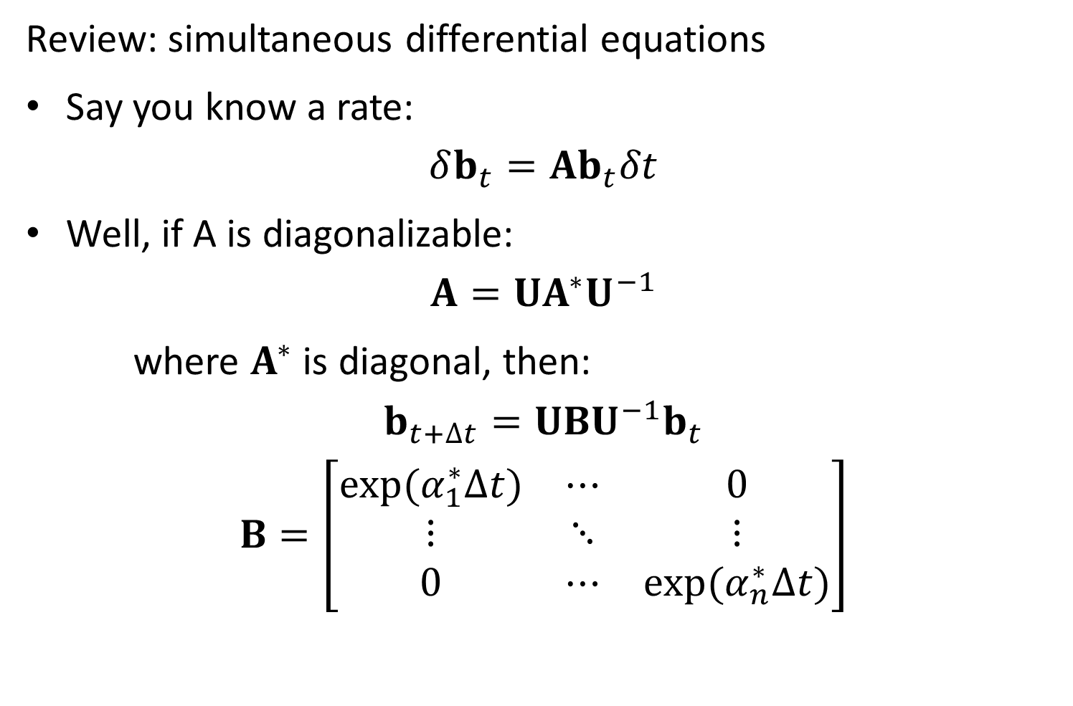
Review: simultaneous differential equations
Say you know a rate:
$$δb_{t}=Ab_{t}δt$$
Well, if A is diagonalizable:
$$A=UA^{∗}U^{−1}$$
where $A^{∗}$ is diagonal, then:
$$b_{t+∆t}=UBU^{−1}b_{t}$$
$$B=\left[\begin{matrix}exp⁡(α_{1}^{∗}∆t) & ⋯ & 0 \\ ⋮ & ⋱ & ⋮ \\ 0 & ⋯ & exp⁡(α_{n}^{∗}∆t)\end{matrix}\right]$$

Slide 10
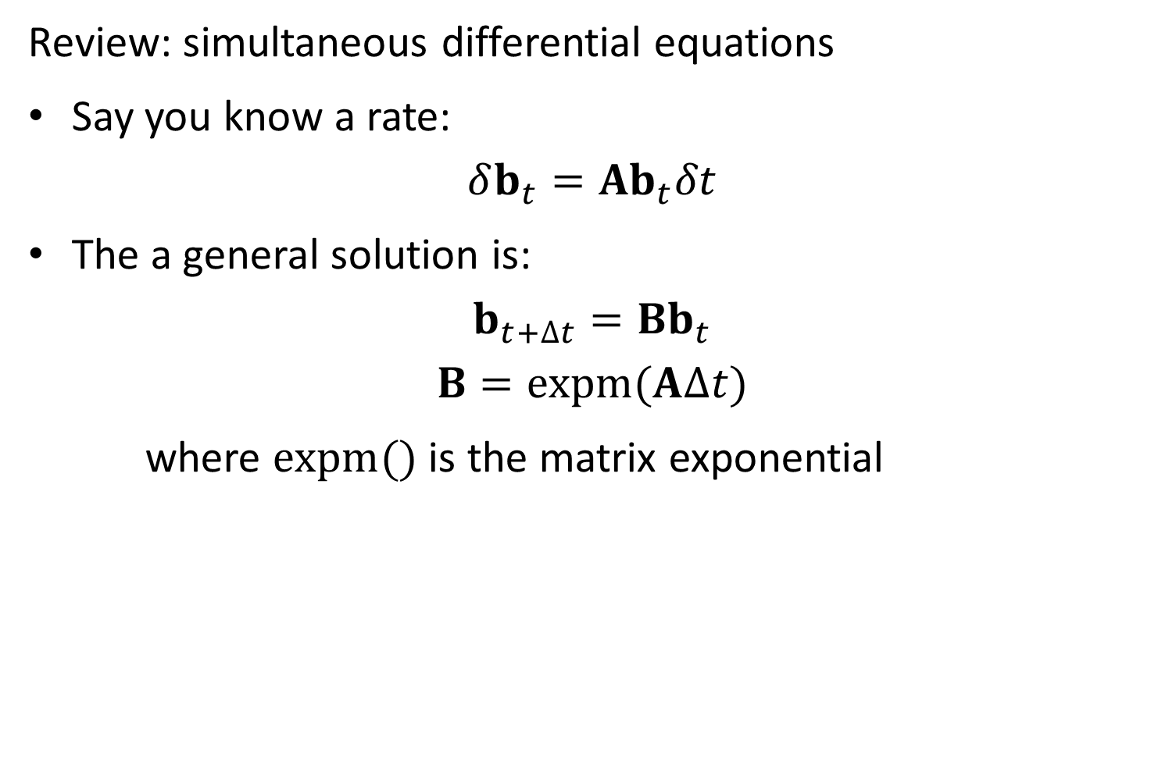
Review: simultaneous differential equations
Say you know a rate:
$$δb_{t}=Ab_{t}δt$$
The a general solution is:
$$b_{t+∆t}=Bb_{t}$$
$$B=expm(A∆t)$$
where $expm()$ is the matrix exponential

Slide 11
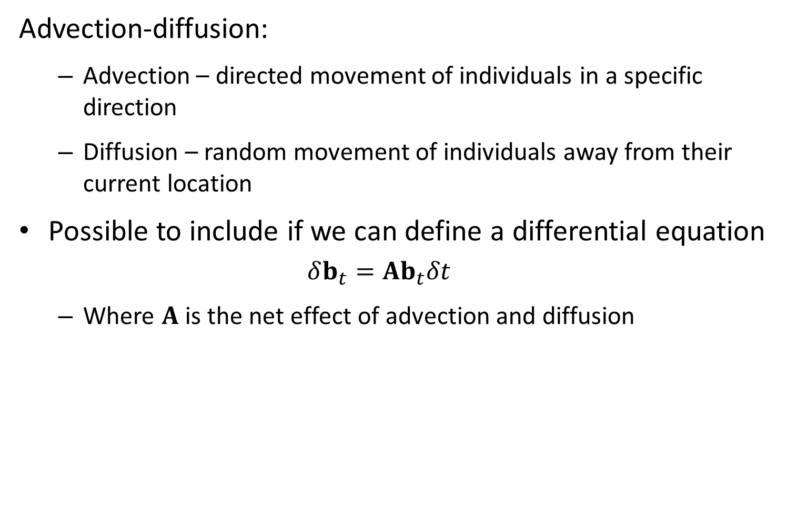
Advection-diffusion:
Advection – directed movement of individuals in a specific direction
Diffusion – random movement of individuals away from their current location
Possible to include if we can define a differential equation
$$δb_{t}=Ab_{t}δt$$
Where $A$ is the net effect of advection and diffusion

Slide 12




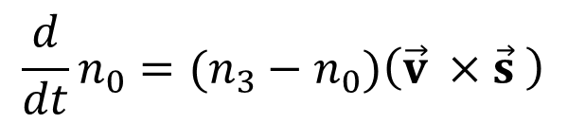

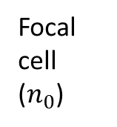
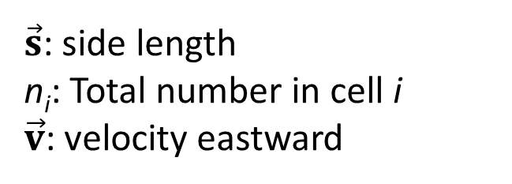

$\vec{s}$: side length
n_{i}: Total number in cell i
$\vec{v}$: velocity eastward
Neighbor 2 ($n_{2}$)
Neighbor 3 ($n_{3}$)
Focal cell ($n_{0}$)
Neighbor 1 ($n_{1}$)
$$\vec{v}$$
$$\vec{s}$$
Neighbor 4 ($n_{4}$)
$$\frac{d}{dt}n_{0}=(n_{3}−n_{0})\left(\vec{v} ×\vec{s} \right)$$

Slide 13





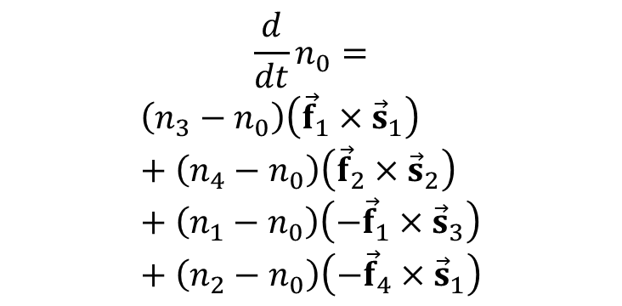
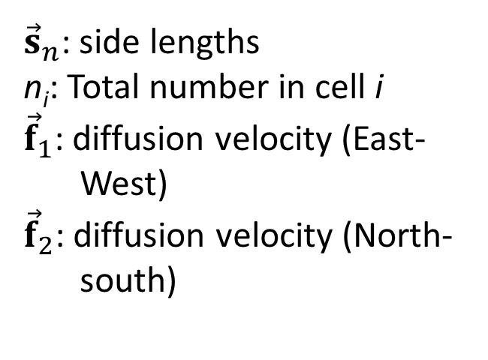

$${\vec{s}}_{2}$$
${\vec{s}}_{n}$: side lengths
n_{i}: Total number in cell i
${\vec{f}}_{1}$: diffusion velocity (East-West)
${\vec{f}}_{2}$: diffusion velocity (North-south)
Neighbor 2 ($n_{2}$)
$${\vec{s}}_{3}$$
Neighbor 3 ($n_{3}$)
Focal cell ($n_{0}$)
$${\vec{f}}_{2}$$
Neighbor 1 ($n_{1}$)
$${\vec{f}}_{1}$$
$${\vec{s}}_{1}$$
Neighbor 4 ($n_{4}$)
$$\frac{d}{dt}n_{0}=$$
$$\left(n_{3}−n_{0}\right)\left({\vec{f}}_{1}×{\vec{s}}_{1}\right)+\left(n_{4}−n_{0}\right)\left({\vec{f}}_{2}×{\vec{s}}_{2}\right)+\left(n_{1}−n_{0}\right)\left(−{\vec{f}}_{1}×{\vec{s}}_{3}\right)+\left(n_{2}−n_{0}\right)\left(−{\vec{f}}_{4}×{\vec{s}}_{1}\right)$$
$${\vec{s}}_{4}$$

Slide 14


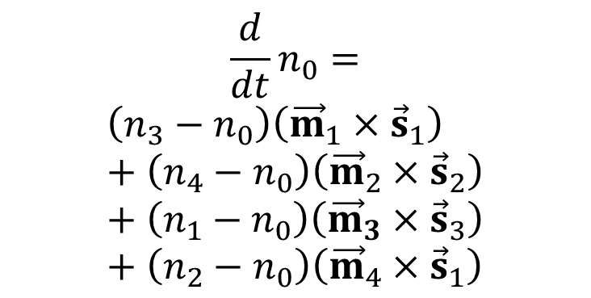

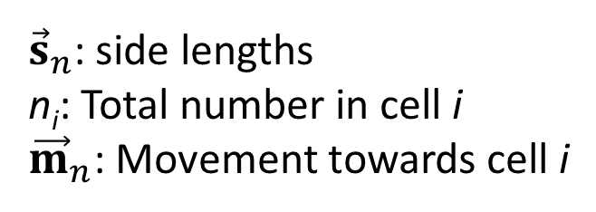

$${\vec{s}}_{2}$$
${\vec{s}}_{n}$: side lengths
n_{i}: Total number in cell i
${\vec{m}}_{n}$: Movement towards cell i
Neighbor 2 ($n_{2}$)
$${\vec{s}}_{3}$$
Neighbor 3 ($n_{3}$)
Focal cell ($n_{0}$)
$${\vec{m}}_{2}$$
Neighbor 1 ($n_{1}$)
$${\vec{m}}_{1}$$
$${\vec{s}}_{1}$$
$${\vec{m}}_{3}$$
$${\vec{m}}_{4}$$
Neighbor 4 ($n_{4}$)
$$\frac{d}{dt}n_{0}=$$
$$\left(n_{3}−n_{0}\right)\left({\vec{m}}_{1}×{\vec{s}}_{1}\right)+\left(n_{4}−n_{0}\right)\left({\vec{m}}_{2}×{\vec{s}}_{2}\right)+\left(n_{1}−n_{0}\right)\left({\vec{m}}_{3}×{\vec{s}}_{3}\right)+\left(n_{2}−n_{0}\right)\left({\vec{m}}_{4}×{\vec{s}}_{1}\right)$$
$${\vec{s}}_{4}$$

Slide 15
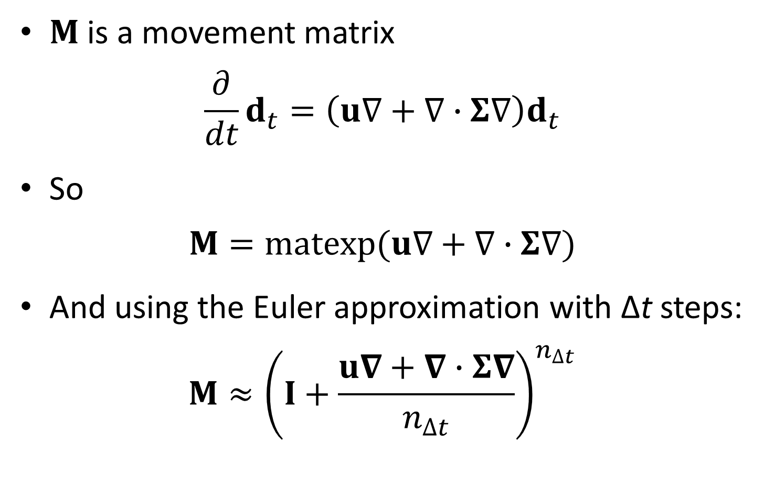
Movement math
$M$ is a movement matrix
$$\frac{∂}{dt}d_{t}=\left(u∇+∇∙Σ∇\right)d_{t}$$
So
$$M=matexp(u∇+∇∙Σ∇)$$
And using the Euler approximation with Δt steps:
$$M≈{\left(I+\frac{u∇+∇∙Σ∇}{n_{∆t}}\right)}^{n_{∆t}}$$

Slide 16
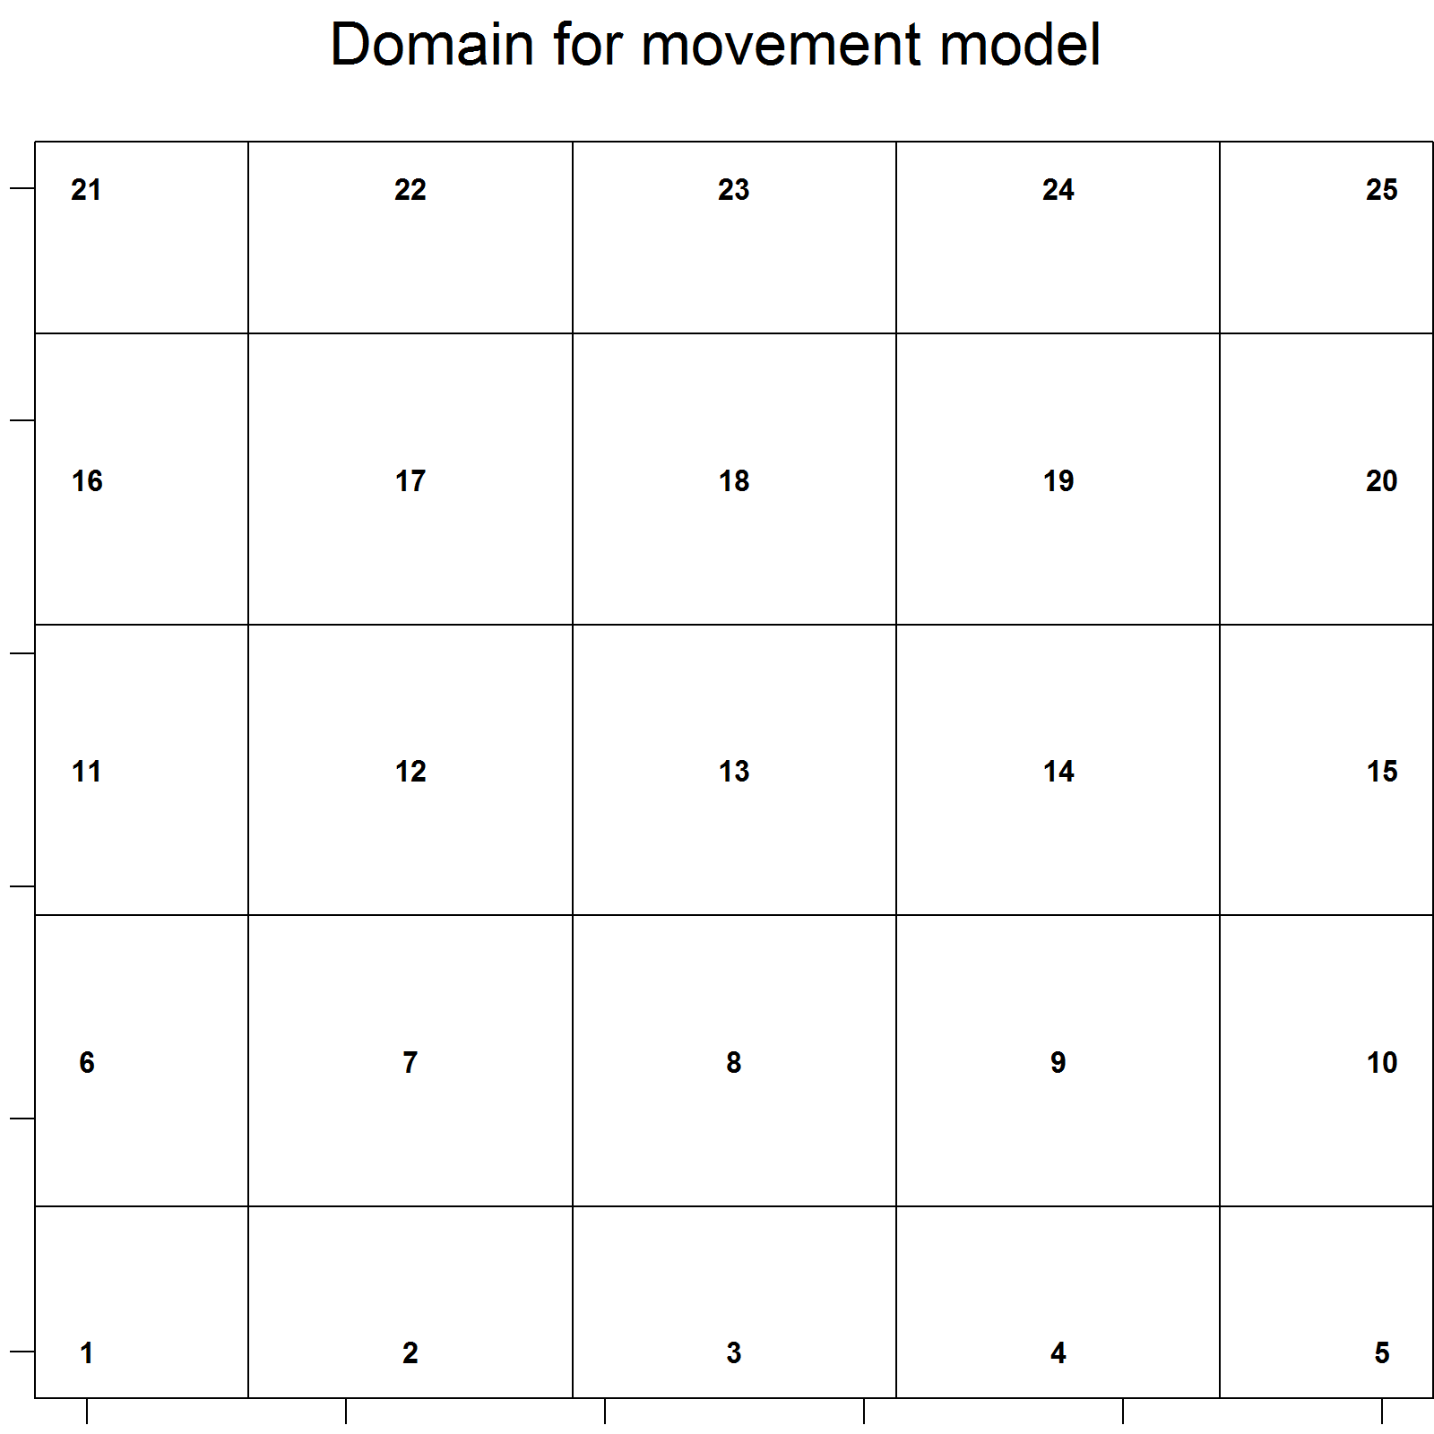
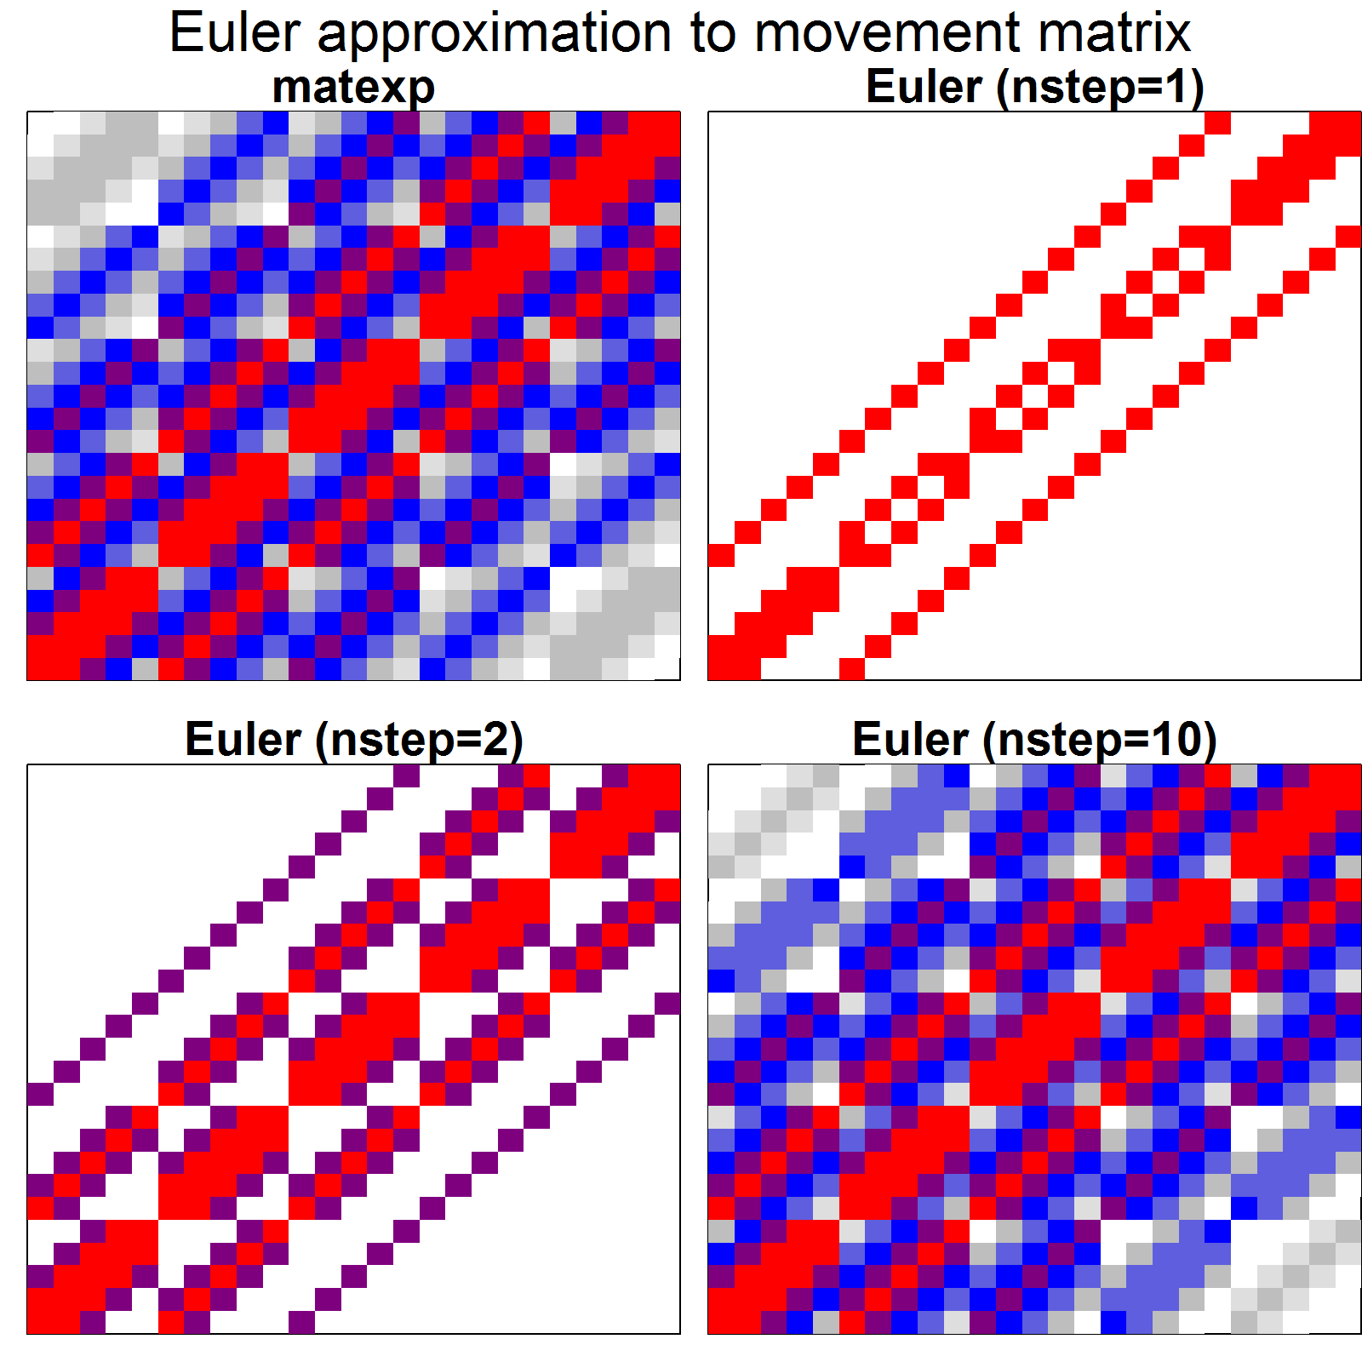
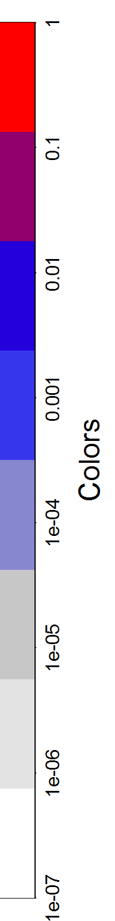
Movement math
Euler approximation is sparse!
Sparseness / accuracy scales with number of steps

Slide 17
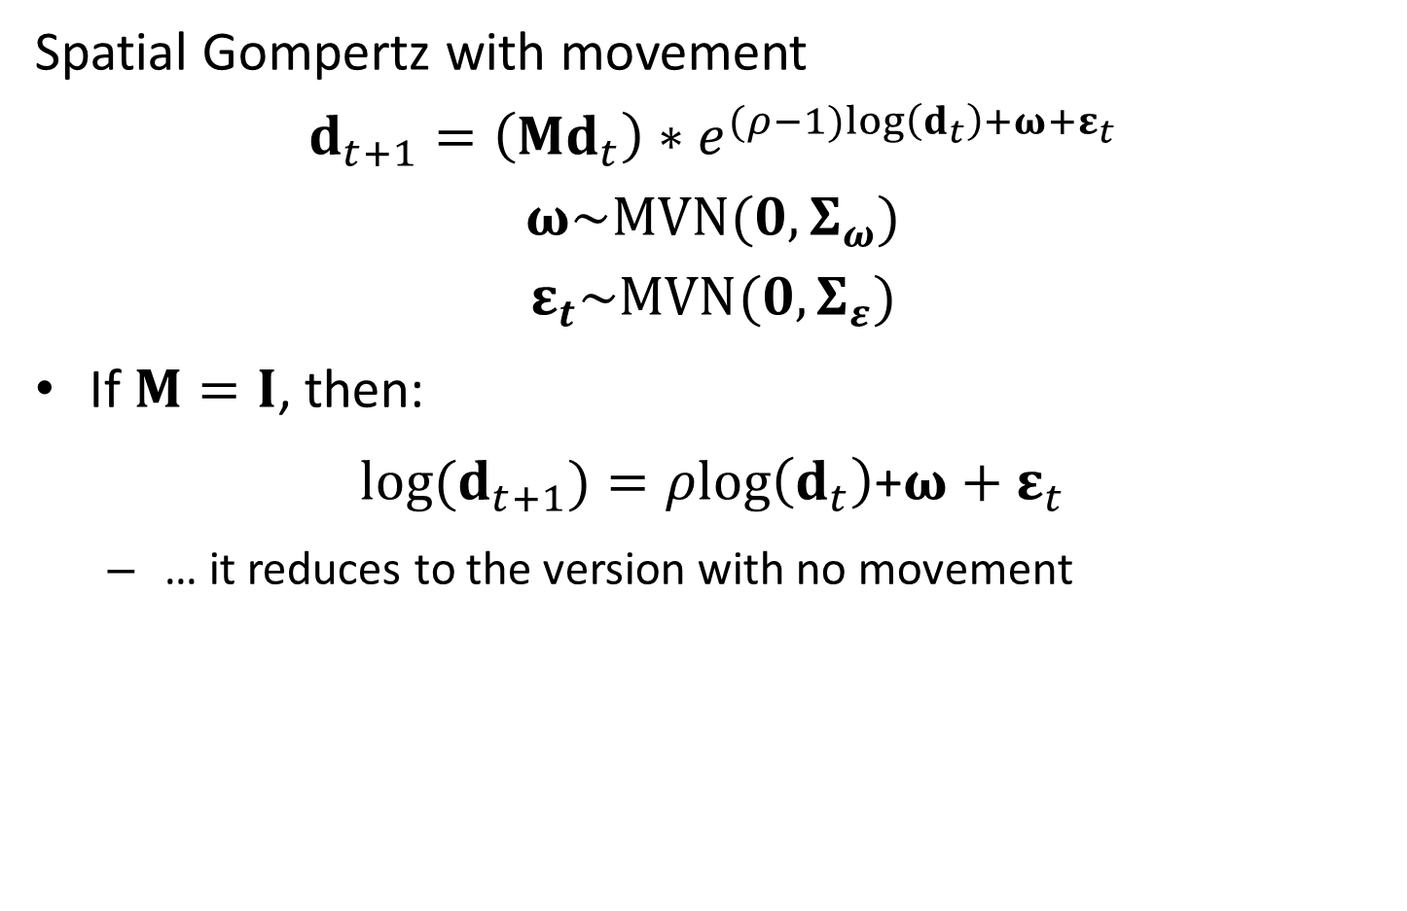
Movement math
Spatial Gompertz with movement
$$d_{t+1}=\left(Md_{t}\right)∗e^{(ρ−1)log\left(d_{t}\right)+ω+ε_{t}}$$
$$ω\sim MVN(0,Σ_{ω})$$
$$ε_{t}\sim MVN(0,Σ_{ε})$$
If $M=I$, then:
$log(d_{t+1})=ρlog\left(d_{t}\right)$+$ω+ε_{t}$
… it reduces to the version with no movement

Slide 18

Movement math
Spatial Gompertz with movement
$$d_{t+1}=\left(Md_{t}\right)∗e^{(ρ−1)log\left(d_{t}\right)+ω+ε_{t}}$$
$$ω\sim MVN(0,Σ_{ω})$$
$$ε_{t}\sim MVN(0,Σ_{ε})$$
Can re-parameterize using sparse matrices
$${\hat{d}}_{t+1}=\left(Md_{t}\right)∗e^{\left(ρ−1\right)log\left(d_{t}\right)+ω}$$
$$ω\sim MVN(0,Σ_{ω})$$
$${log(d}_{t})\sim MVN(log({\hat{d}}_{t}),Σ_{ε})$$

Slide 19
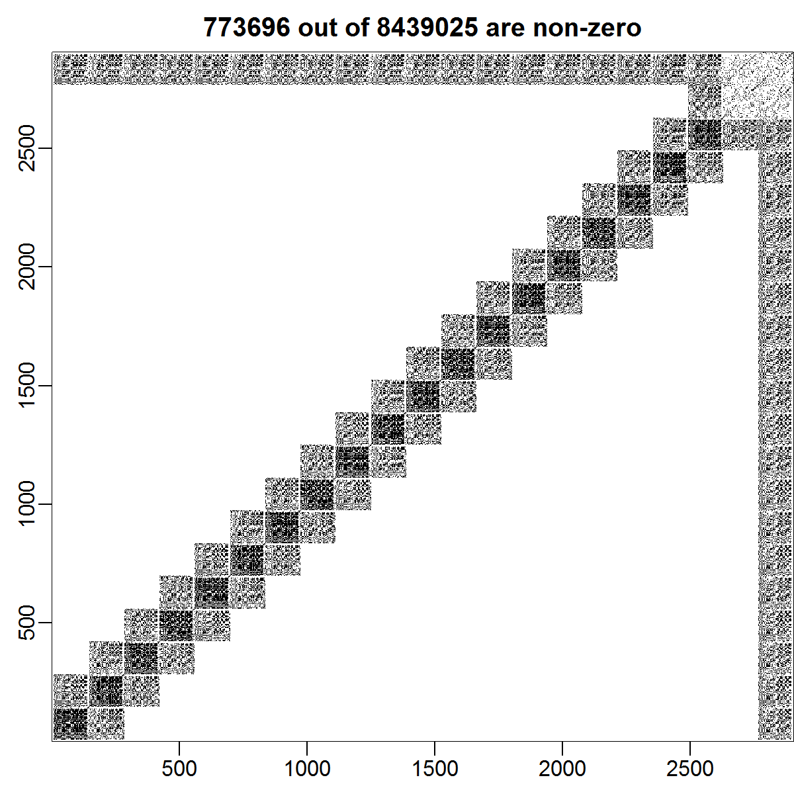
Movement math
Sparse matrix
Easier computation
Less computer memory
Faster speed

Slide 20
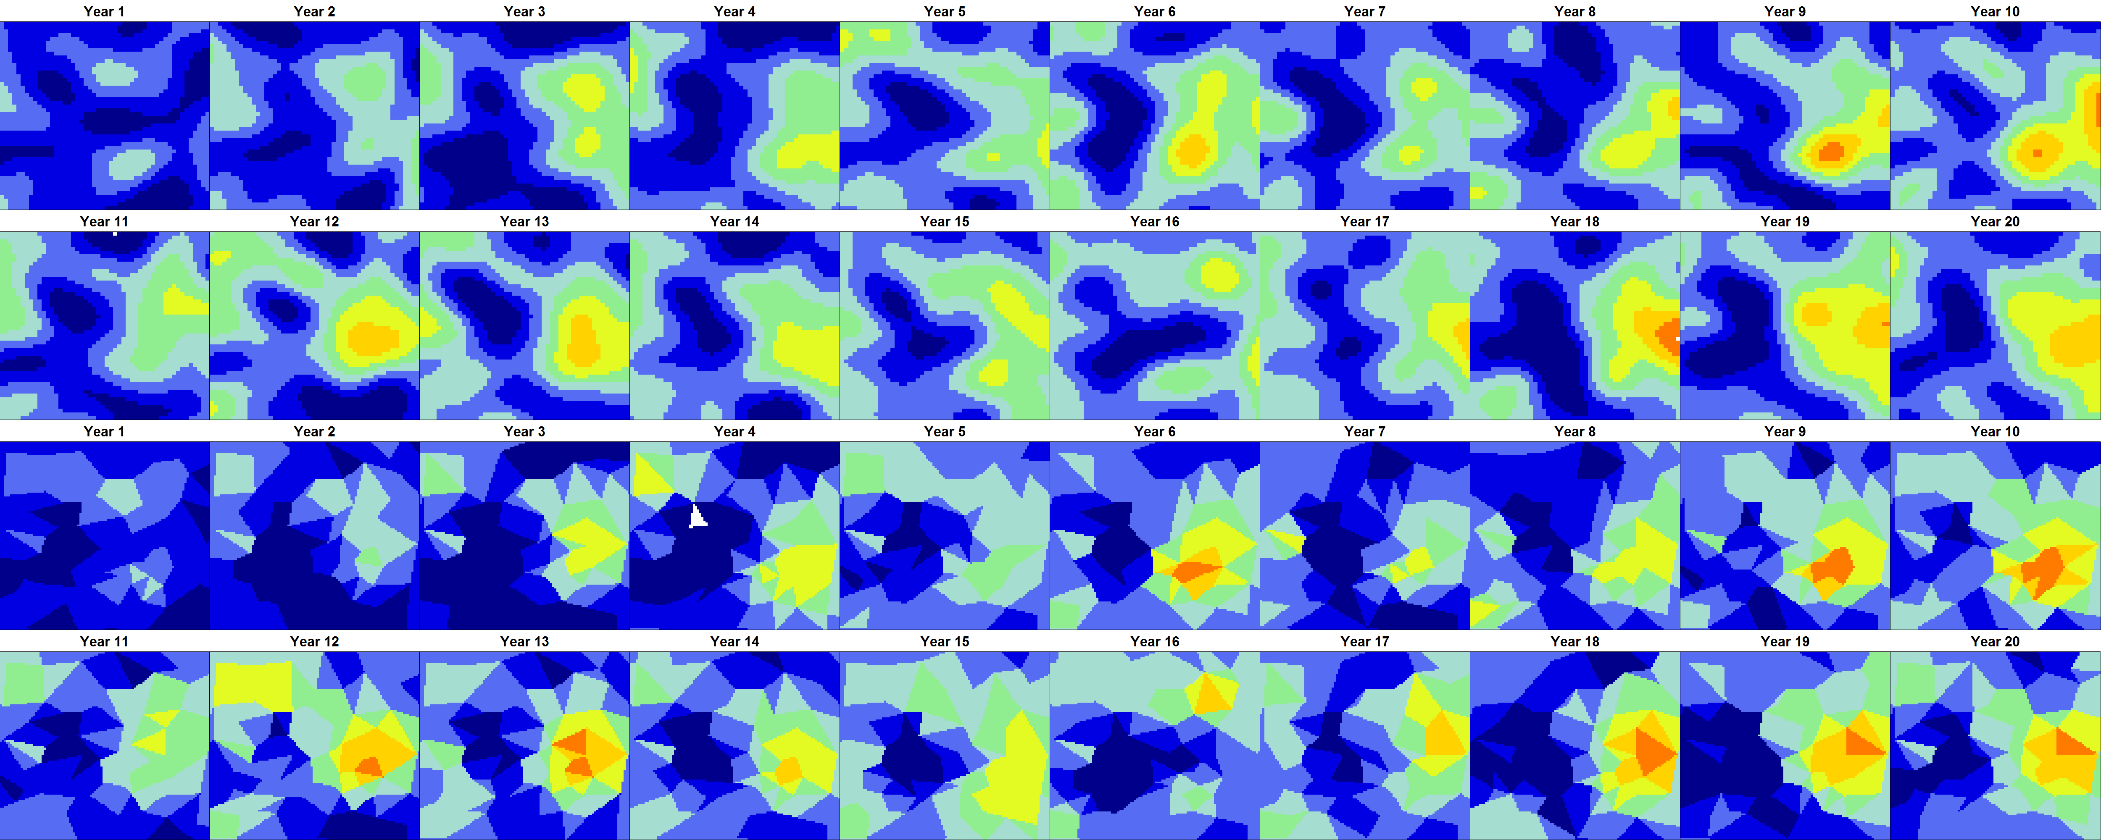
Movement math
Highly separable computation
200 triangles + 20 years = 5 min. on laptop
Seems to recovery dynamics and density
Est / True
Est / True

Slide 21
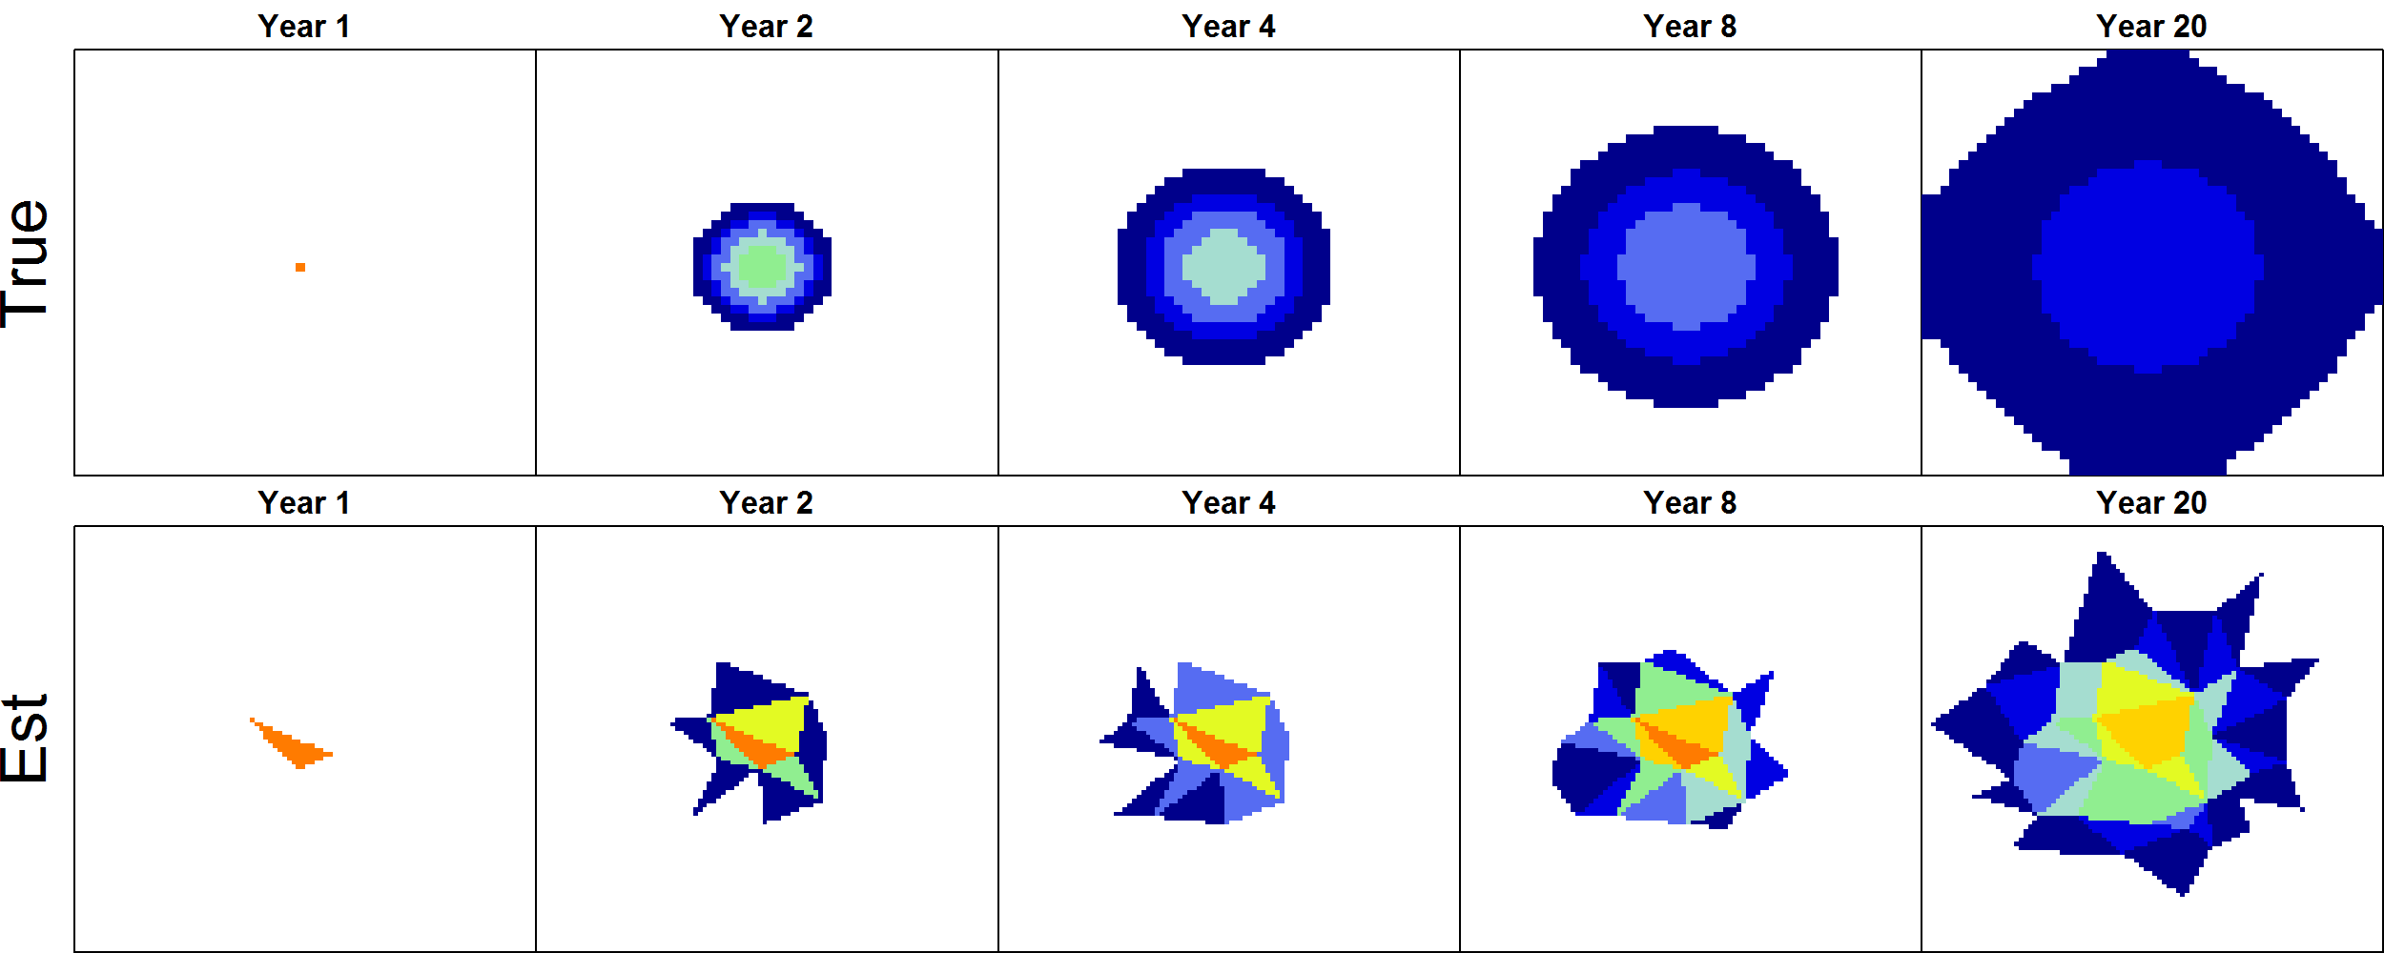
Movement math
Movement can be estimated using count data
Euler approximation is sufficient for local advection-diffusion

